Slide 1
Chapter 4: Threads

Slide 2
Chapter 4: Threads
Overview
Multithreading Models
Threading Issues
Pthreads
Windows XP Threads
Linux Threads
Java Threads

Slide 3

Single and Multithreaded Processes

Slide 4
Benefits
Responsiveness
Resource Sharing
Economy
Utilization of MP Architectures

Slide 5
User Threads
Thread management done by user-level threads library
Three primary thread libraries:
  POSIX Pthreads
  Win32 threads
  Java threads

Slide 6
Kernel Threads
Supported by the Kernel
Examples
  Windows XP/2000
  Solaris
  Linux
  Tru64 UNIX
  Mac OS X

Slide 7
Multithreading Models
Many-to-One
One-to-One
Many-to-Many

Slide 8
Many-to-One
Many user-level threads mapped to single kernel thread
Examples:
  Solaris Green Threads
  GNU Portable Threads

Slide 9

Many-to-One Model

Slide 10
One-to-One
Each user-level thread maps to kernel thread
Examples
  Windows NT/XP/2000
  Linux
  Solaris 9 and later

Slide 11

One-to-one Model

Slide 12
Many-to-Many Model
Allows many user level threads to be mapped to many kernel threads
Allows the operating system to create a sufficient number of kernel threads
Solaris prior to version 9
Windows NT/2000 with the ThreadFiber package

Slide 13

Many-to-Many Model

Slide 14
Two-level Model
Similar to M:M, except that it allows a user thread to be bound to kernel thread
Examples
  IRIX
  HP-UX
  Tru64 UNIX
  Solaris 8 and earlier

Slide 15

Two-level Model

Slide 16
Threading Issues
Semantics of fork() and exec() system calls
Thread cancellation
Signal handling
Thread pools
Thread specific data
Scheduler activations

Slide 17
Semantics of fork() and exec()
Does fork() duplicate only the calling thread or all threads?

Slide 18
Thread Cancellation
Terminating a thread before it has finished
Two general approaches:
  Asynchronous cancellation terminates the target thread immediately
  Deferred cancellation allows the target thread to periodically check if it should be cancelled

Slide 19
Signal Handling
Signals are used in UNIX systems to notify a process that a particular event has occurred
A signal handler is used to process signals
  Signal is generated by particular event
  Signal is delivered to a process
  Signal is handled
Options:
  Deliver the signal to the thread to which the signal applies
  Deliver the signal to every thread in the process
  Deliver the signal to certain threads in the process
  Assign a specific threa to receive all signals for the process

Slide 20
Thread Pools
Create a number of threads in a pool where they await work
Advantages:
  Usually slightly faster to service a request with an existing thread than create a new thread
  Allows the number of threads in the application(s) to be bound to the size of the pool

Slide 21
Thread Specific Data
Allows each thread to have its own copy of data
Useful when you do not have control over the thread creation process (i.e., when using a thread pool)

Slide 22
Scheduler Activations
Both M:M and Two-level models require communication to maintain the appropriate number of kernel threads allocated to the application
Scheduler activations provide upcalls - a communication mechanism from the kernel to the thread library
This communication allows an application to maintain the correct number kernel threads

Slide 23
Pthreads
A POSIX standard (IEEE 1003.1c) API for thread creation and synchronization
API specifies behavior of the thread library, implementation is up to development of the library
Common in UNIX operating systems (Solaris, Linux, Mac OS X)

Slide 24
Windows XP Threads
Implements the one-to-one mapping
Each thread contains
  A thread id
  Register set
  Separate user and kernel stacks
  Private data storage area
The register set, stacks, and private storage area are known as the context of the threads
The primary data structures of a thread include:
  ETHREAD (executive thread block)
  KTHREAD (kernel thread block)
  TEB (thread environment block)

Slide 25
Linux Threads
Linux refers to them as tasks rather than threads
Thread creation is done through clone() system call
clone() allows a child task to share the address space of the parent task (process)

Slide 26
Java Threads
Java threads are managed by the JVM
Java threads may be created by:
  Extending Thread class
  Implementing the Runnable interface

Slide 27
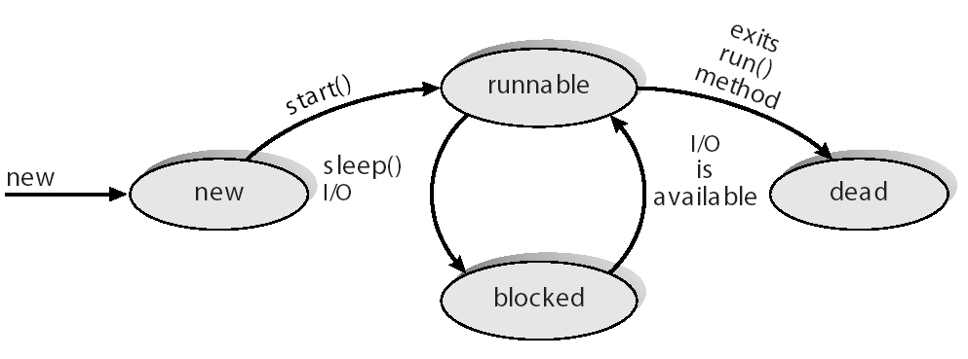
Java Thread States

Slide 28
End of Chapter 4

